Slide 1


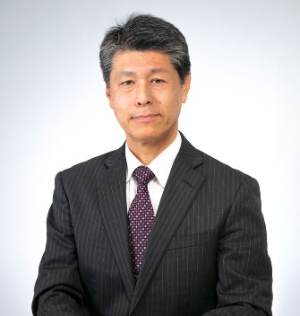
Introduction of Shizuoka University,
Faculty of Engineering
jó reggelt kívánok
（ヨーレッゲルトキヴーノク）
Mitsuhiro Fukuta
Dean, Faculty of Engineering
Notes:
1.I will introduce Hamamatsu Campus in Shizuoka University briefly.
1.Good morning everyone. Welcome to Hamamatsu and Shizuoka University.
2.I am Sako, Dean of Graduate School of Engineering.
3.I am happy to invite you to our campus.
4.I will introduce Hamamatsu campus briefly.
5.Is it the first time to come to Japan?
6.It is summer time, very hot and humid.
7.The temperature is more than 30 deg.C.
8.How is your country? Very hot like Japan?
9.I want to go to Indonesia. But I have never been to your county.
10.It is time to explain my faculty.
11.It is about 15 min. Then you have laboratory tour .

Slide 2
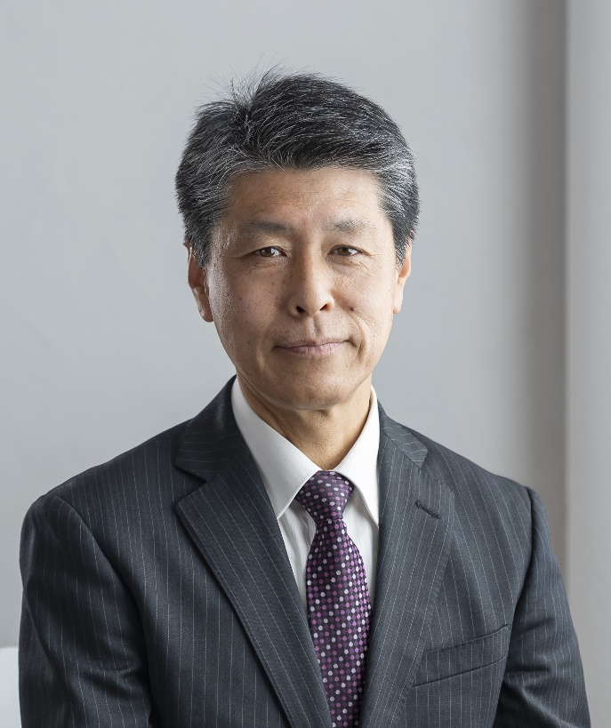
Self-introduction
Mitsuhiro Fukuta,
Ph.D. (Kyoto university, 1995)
Dean, Faculty of Engineering, Shizuoka University
Audit & Supervisory Board Member of SUZUKI motor corp.
My major
Mechanical Engineering
Fluid Engineering, Fluid machinery
My research field
Refrigerant Compressor
Instrumentation in refrigeration cycle
Development of new refrigeration system with low GWP refrigerant

Slide 3
Purpose of my visiting
To enhance the relationship between both universities
  To match the researches of both universities in the same research area
  To invite the researcher to Shizuoka university by the support of SUZUKI foundation.

Slide 4
Introduction of Shizuoka University
  Location of campus
  History
  Departments
  International student
Student exchange
  ABP : accepting students from Asian countries
  SSSV : sending students to foreign countries
Relationship between BME and Shizuoka Univ.
  Inter Academia
  Suzuki foundation
(ÓE)

Slide 5
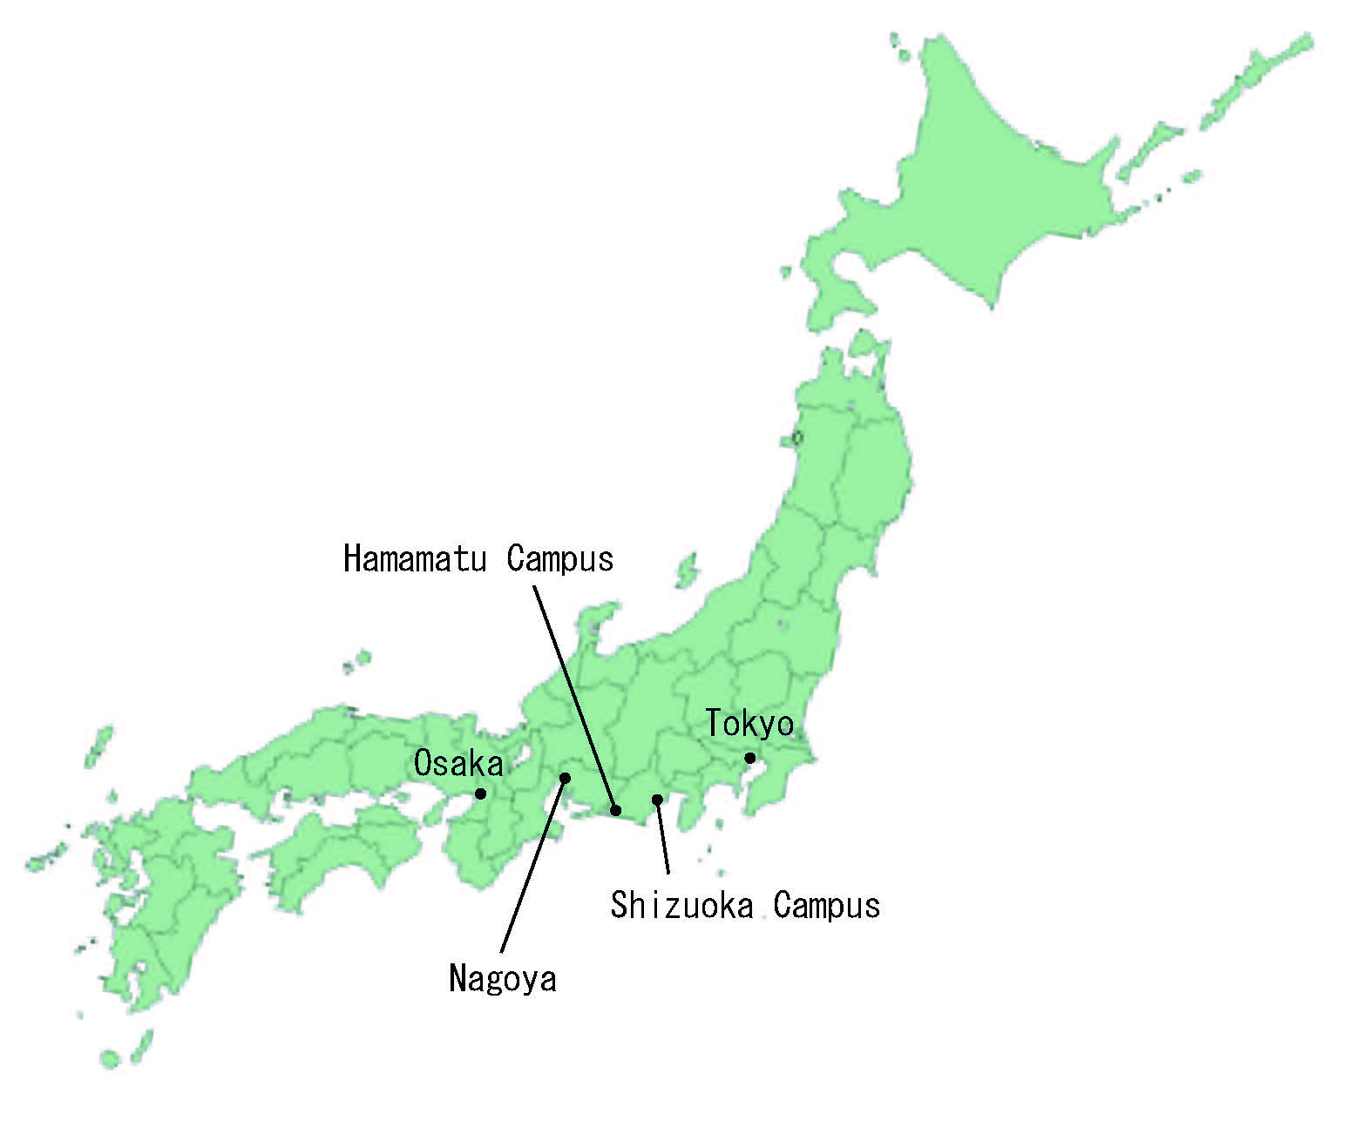
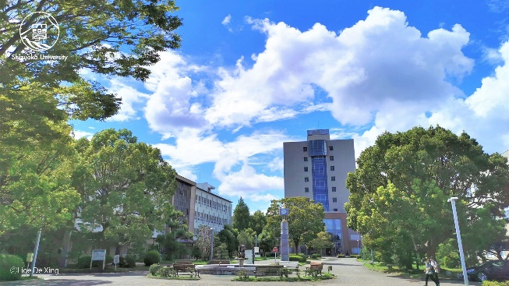

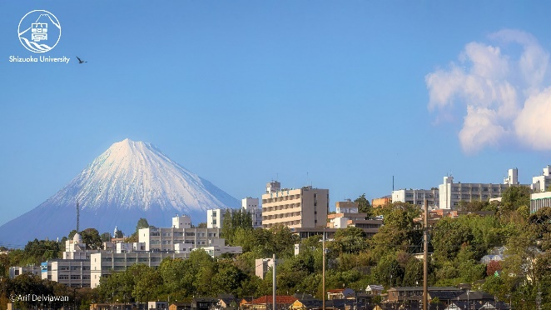
Location of Hamamatsu & Shizuoka campuses
Hamamatsu city is in the central area of Japan, just middle between Tokyo and Osaka.
Hamamatsu Campus
Shizuoka Campus
Notes:
Here is the location of Hamamatsu and Shizuoka campuses.
Hamamatsu campus is here and Shizuoka campus is here.
Shizuoka is middle of Japan.
.

Slide 6

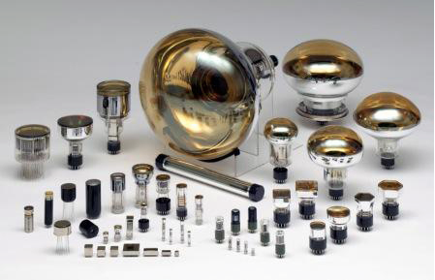
Hamamatsu is very industrial city!
Hamamatsu Photonics is located in our city.
Notes:
Here Hamamatsu city is very industrial cities. There are many famous global companies.

Slide 7

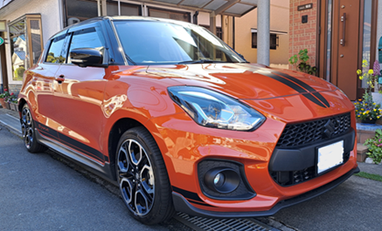

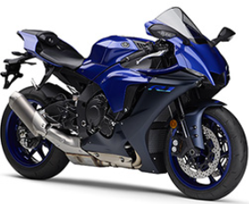


Suzuki Motors
Yamaha Motors
Yamaha Music Instruments
Honda
and Kawai Music Instruments, Roland, etc.
Notes:
In others, global mobile companies Yamaha moters,…, are here in Hamamatsu. Some foreign students work for these companies.

Slide 8
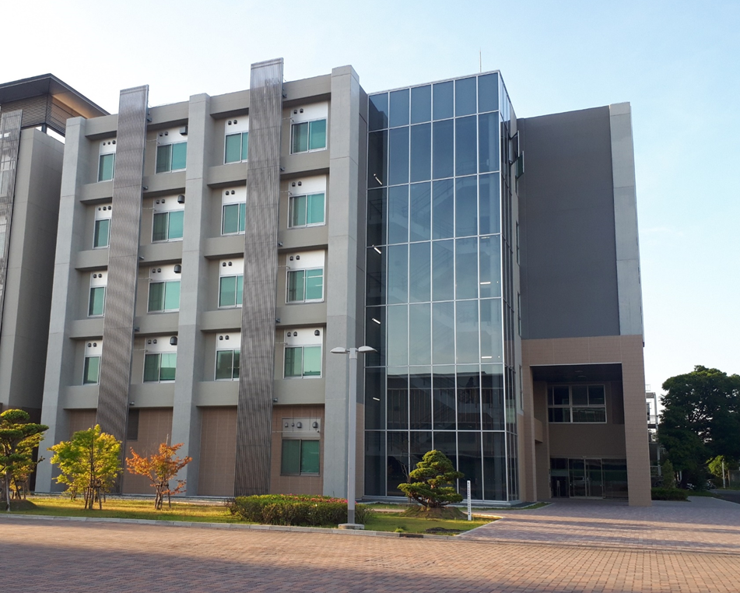
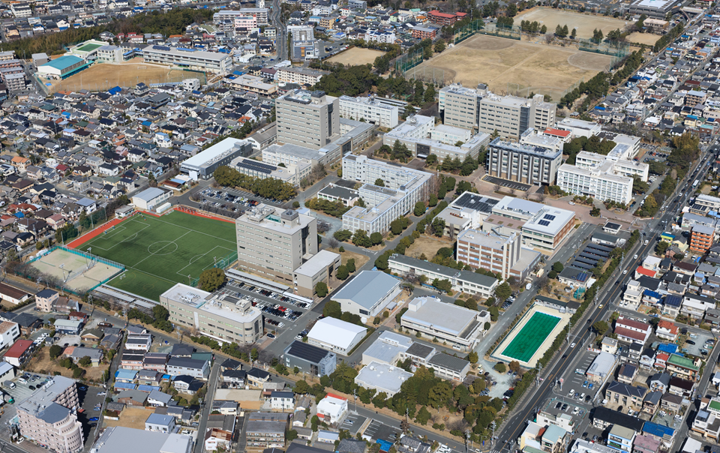
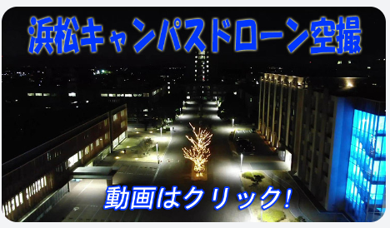
Hamamatsu campus
131,600m²
Notes:
This is the full view of Hamamatsu campus.
There are more than 20 buildings here.
We have 2 faculties and 2 research institutes in this campus.
Now we are here close to entrance gate.

Slide 9
Faculties
Shizuoka campus
Faculty of Humanities and Social Sciences
Faculty of Education
Faculty of Science
Faculty of Agriculture
Faculty of Global Interdisciplinary Science and Innovation
Graduate
Schools
＋
Hamamatsu campus:
Faculty of Engineering
Faculty of Informatics
Graduate
Schools
＋
Notes:
ShizuokaUniv has about 10 thousands students, and 3500 students are here in hamamatstu campus.

Slide 10
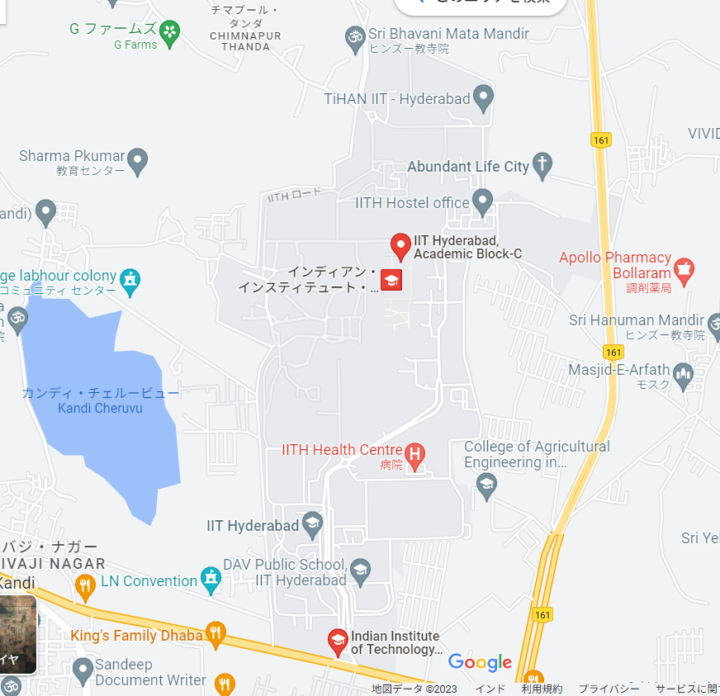
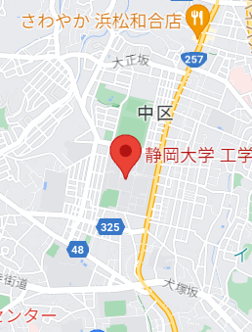
Hamamatsu campus
Notes:
This is the full view of Hamamatsu campus.
There are more than 20 buildings here.
We have 2 faculties and 2 research institutes in this campus.
Now we are here close to entrance gate.

Slide 11
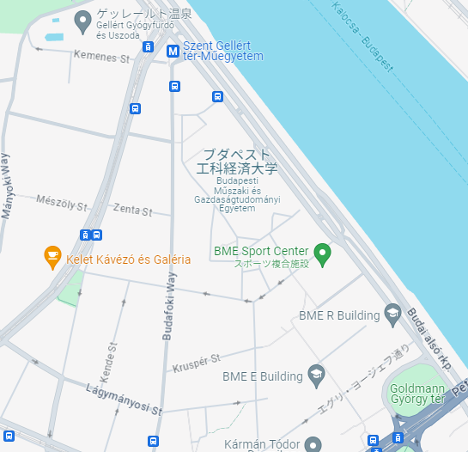
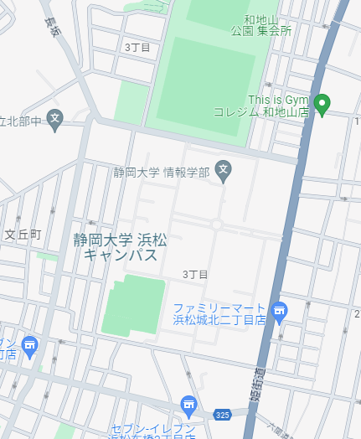
Hamamatsu campus
BUDAPEST UNIVERSITY OF TECHNOLOGY AND ECONOMICS
SHIZUOKA UNIV.
Hamamatsu Campus
Notes:
This is the full view of Hamamatsu campus.
There are more than 20 buildings here.
We have 2 faculties and 2 research institutes in this campus.
Now we are here close to entrance gate.

Slide 12
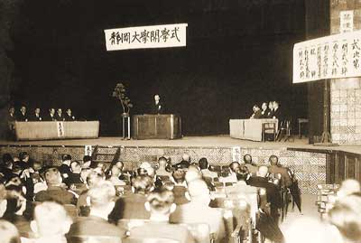
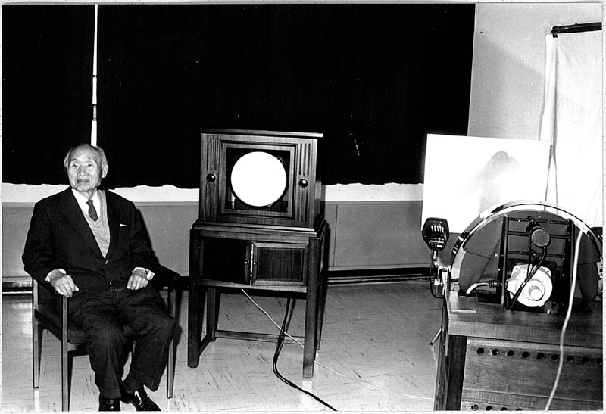

History of the University
Shizuoka
Prefectural
Hamamatsu
Normal School
(Established
Mar.1914)
Hamamatsu
Technical High
School
(Established
Oct.1922)
Shizuoka
Prefectural
Training Center
For Supplementary
Agriculture School
Teachers
(Established
Feb.1926)
Shizuoka
Normal School
(Established
Jan.1875)
Shizuoka University
(Established May 31.1949）
100th anniversary!(2022)
Opening Ceremony of Shizuoka University (Dec.3,1949)
Prof. Kenjiro Takayanagi successfully sent TV images first in the world.
Notes:
Last year It’s 100th anniversary of the founding of the faculty of Eng..

Slide 13
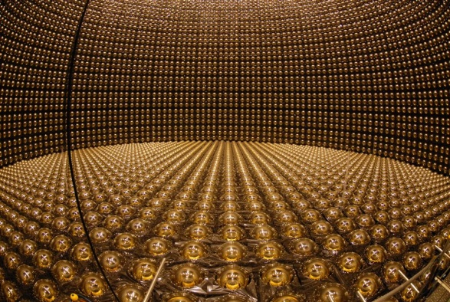
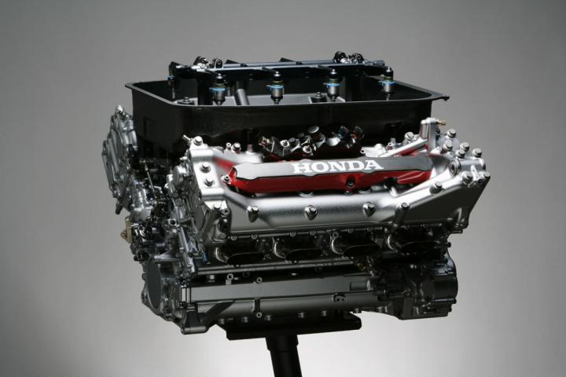
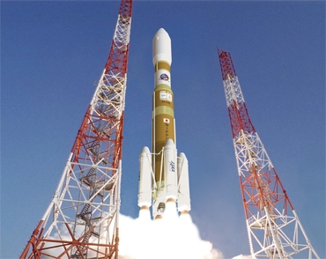
Alumni of faculty of engineering
Haruyama（Sharp）：Developed first TV with Dr. Takayanagi
Soichiro Honda（Honda)：Established HONDA
Hiruma&Suzuki（Hamamatsu Photonics）：The biggest PMT in the world used in Kamiokande to detect neutrino
Fujita, Sakamoto&Shimodaira(Seiko)：Developed quartz watch
Otsuki（Sony）：Developed AIBO
Takano （Victor）；Developed VHS recorder
Kawashima&Kume（Honda）：
Developed low emission engine「CVCC engine」
Shinmura（Honda）：Developed F1 engine
Kojima（Japan Aviation Electronics）：Developed controller for H2 Rocket

Slide 14
Faculty of Engineering
Mechanical Engineering (160)
Electrical and Electronic Engineering (110)
Faculty of Engineering
(540)
Electronics and Materials Science (110)
Applied Chemistry and Biochemical Engineering (110)
170 professors
40 technical staff
Mathematical and Systems Engineering (50)
Notes:
Our faculty has 5 Departments: Mechanical Engineering,.........
3.Total number of students for one year is 540.

Slide 15
Graduate School of
Integrated Science and Technology
Mechanical Engineering (98)
Electrical and Electronic Engineering (63)
Electronics and Materials Science (66)
Master’s Program
(322)
Applied Chemistry and Biochemical Engineering (63)
Mathematical and Systems Engineering (24)
Management of Business Development (8)
Notes:
Here is Graduate School of Engineering, In master course, We have 6 courses like this,
Total number of students for one year is 322.

Slide 16
Goal of education in engineering field
1. Engineers with specialized knowledge
and skills
2. Engineers with manufacturing spirit and
techniques
3. Engineers with global spirit
Notes:
1.This is the goal of education in engineering field.
2.We develop engineers with specialized knowledge and skills, with manufacturing spirit and techniques and with global education.
3.I will introduce facilities to achieve these educational goal in our faculty.
.

Slide 17
Monozukuri training for 1st year students
Monozukuri training is done to the first-year students in all departments for one year.
《first semester》 Introduction to Manufacturing Techniques
《second semester》 Technical Application for Creative Manufacturing
learn
make
create
Students learn the basic knowledge necessary for Monozukuri, such as digital circuits and programming.
Each student builds a three-wheeled autonomous robot controlled by a microcomputer.
Students collaborate in a group to create a robot to complete a contest mission.
Notes:
学部4年間の教育は、全学教育科目から、専門科目へと，学年とともに変化していきます。通常大学では1年生の講義は教養科目が中心ですが、工学部では、ものづくり実習科目を置き、ものづくりの経験を早期に体験することにしています。

Slide 18
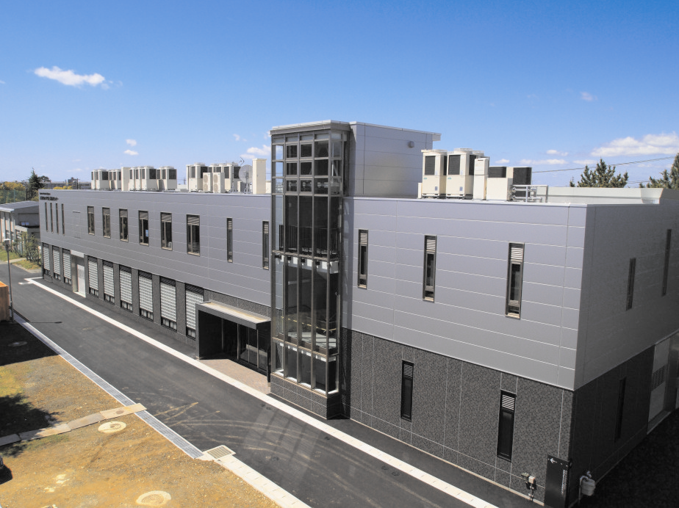
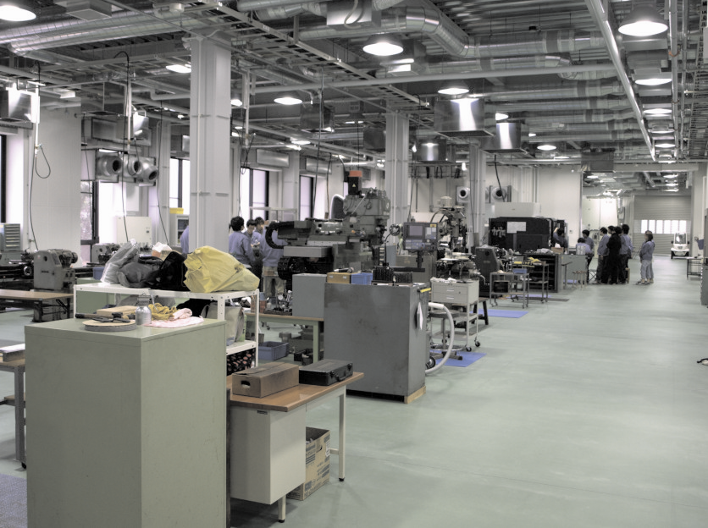
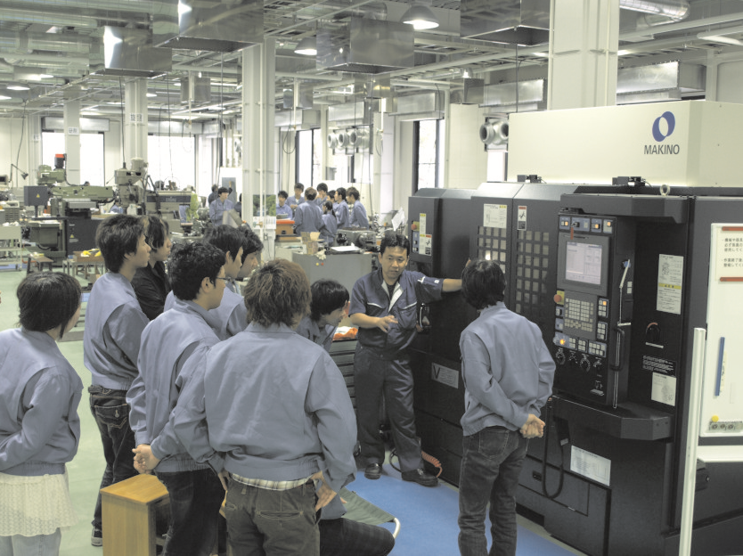
Center for Creative Engineers
A lot of machines in machine shop
Machine shop practice of
undergraduate students
Notes:
1.A lot of machines are in the building.
2.And some machines are most-advanced manufacturing machines.

Slide 19
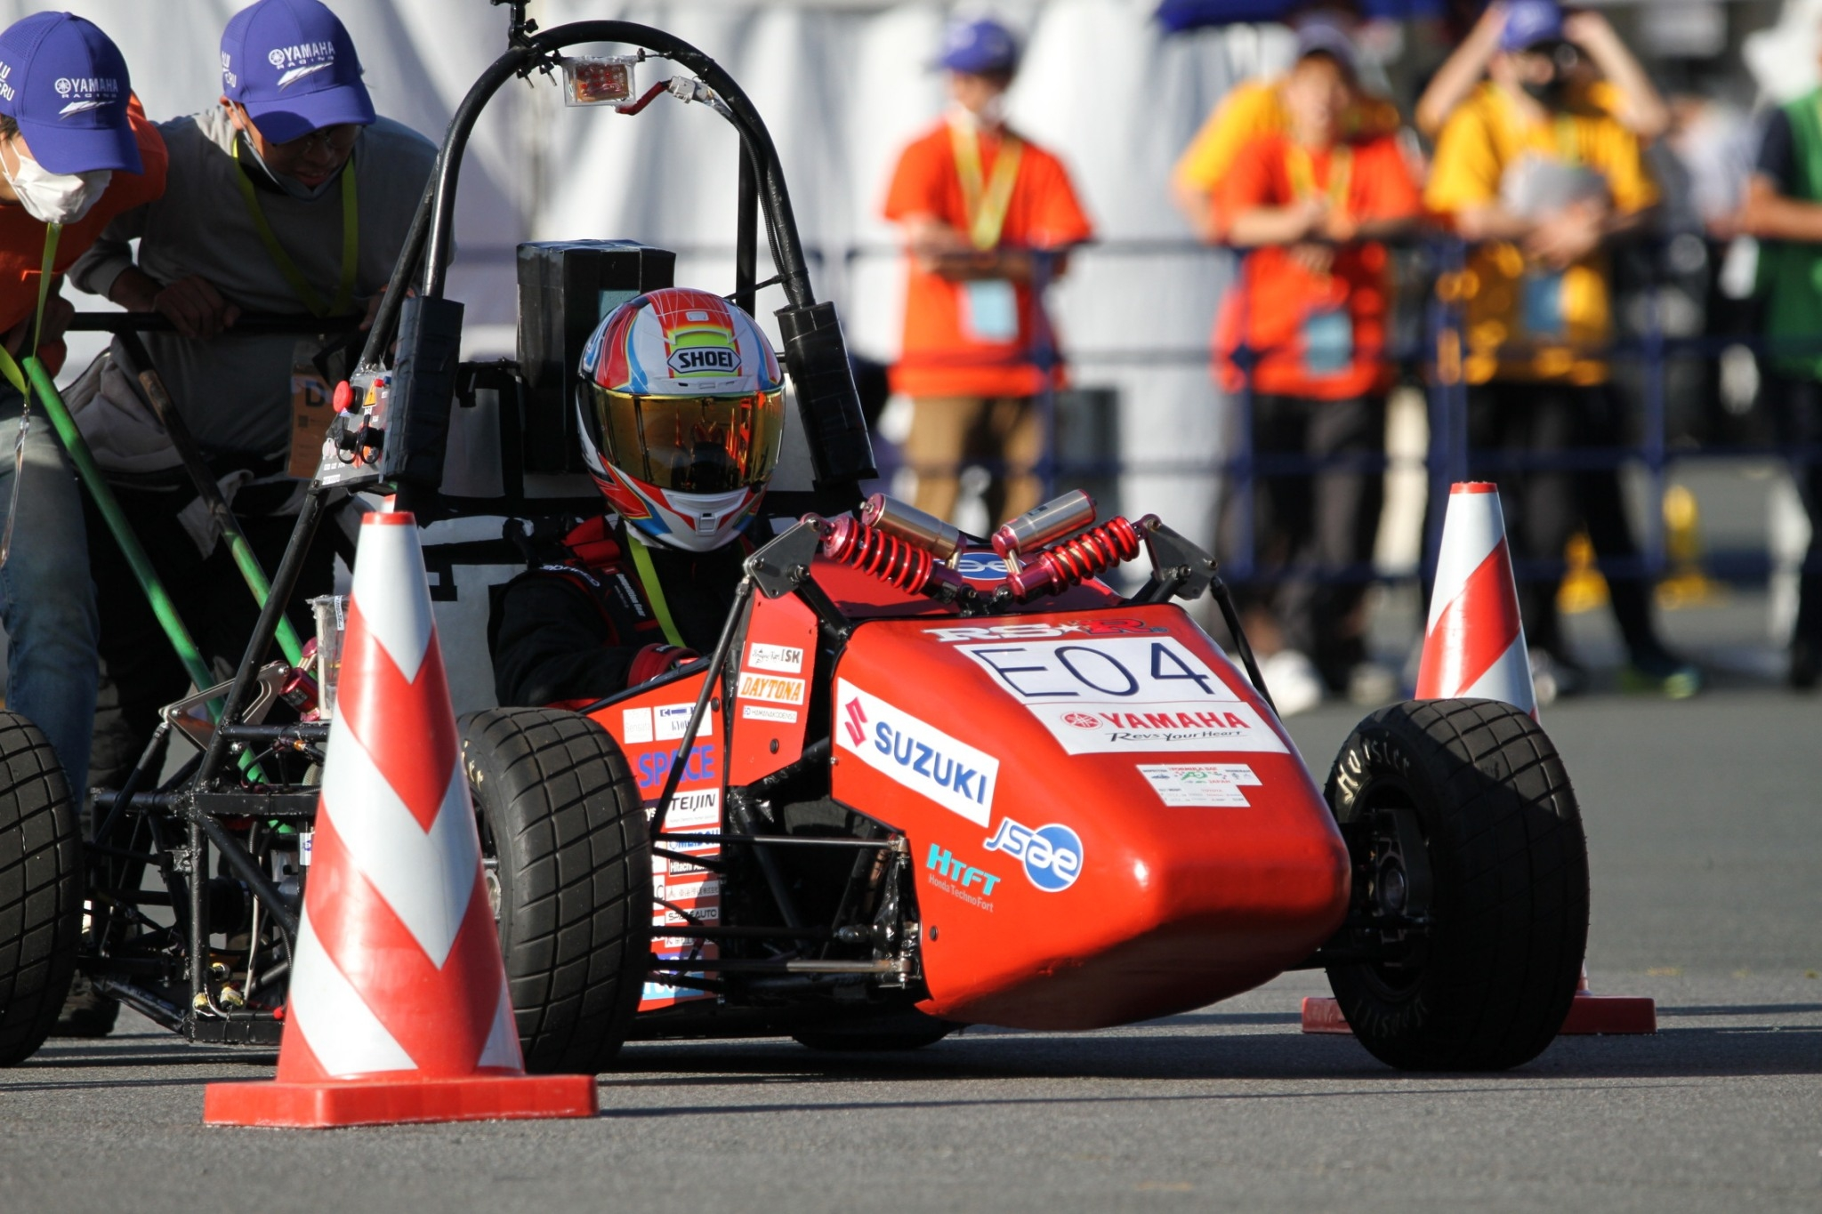
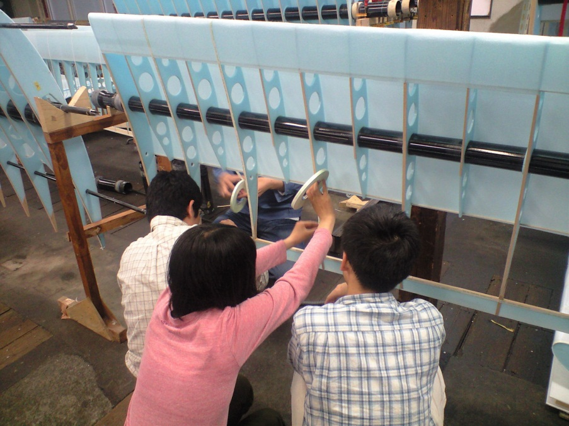
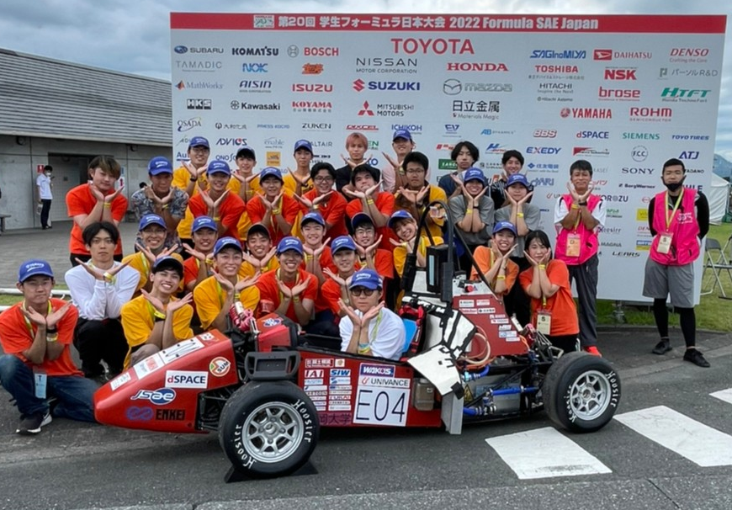
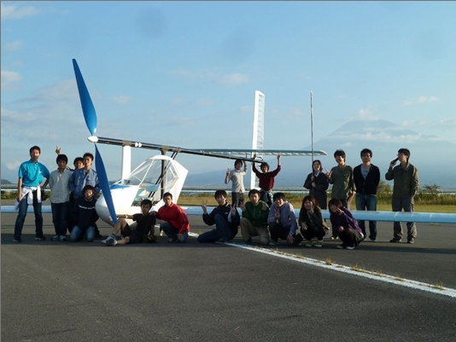
Shizuoka University Motors
Formula competition
Human-powered
airplane race
http://sum-fsae.com/
http://suac.under.jp/
Notes:
19
1.I will show 2 kinds of real manufacturing in our faculty.
1.We encourage the students to study manufacturing technique in various student circles.
2.The first example is Shizuoka University Motors. The students plan, design and produce the formula car by themselves. And they enter race.
3.The second is human-powered airplane. The student produce the airplane and enter a competition.
4.We support these student activities.

Slide 20
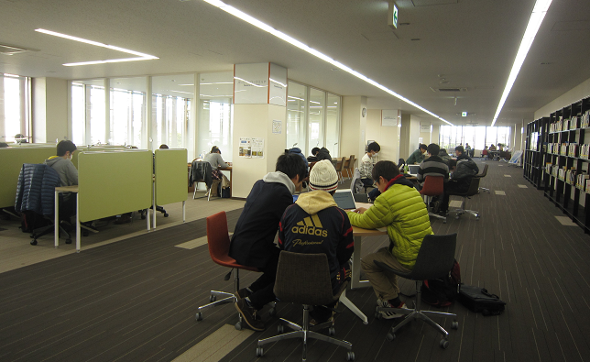
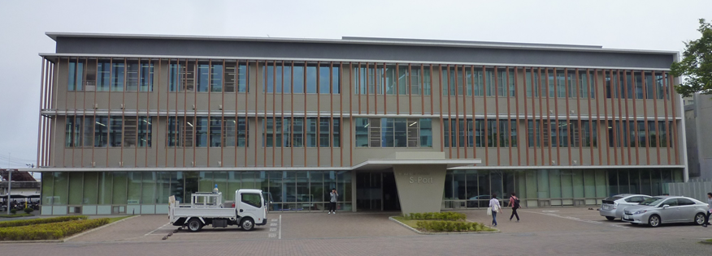
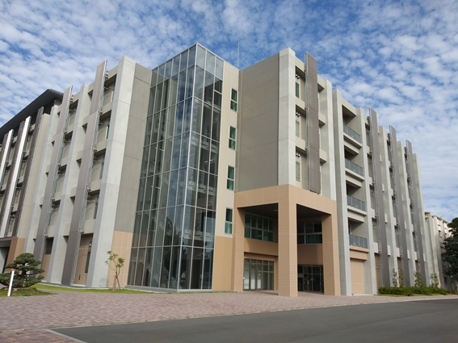
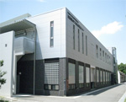
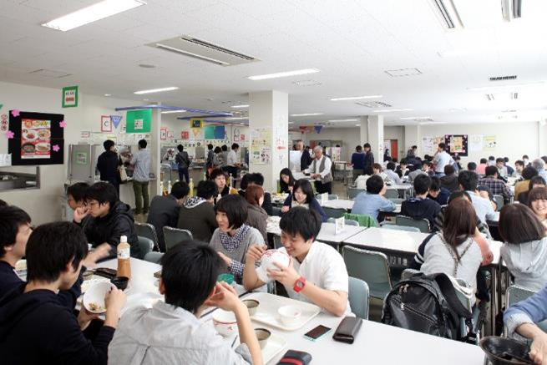
Facilities
S-Port (Student Port)
Library
Cafeteria
Research Institute of Electronics
Manufacturing Center
Notes:
Here is typical facilities in Hamamatsu campus.

Slide 21
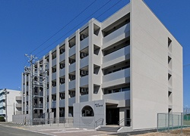
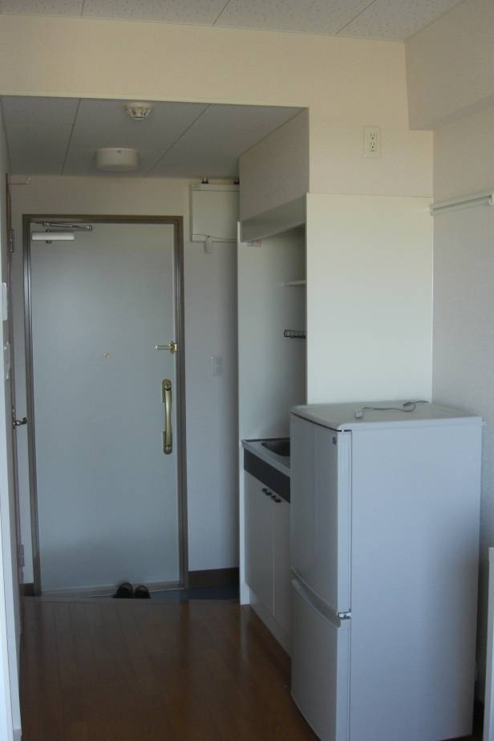
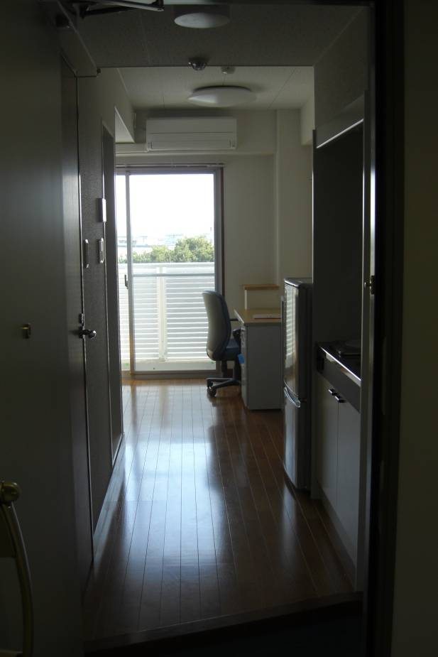
Dormitory for foreign students in Hamamatsu
Capacity of foreign students is around 75.
Notes:
1.This is the dormitory for foreign students.
2.The capacity of foreign students is around 75.

Slide 22
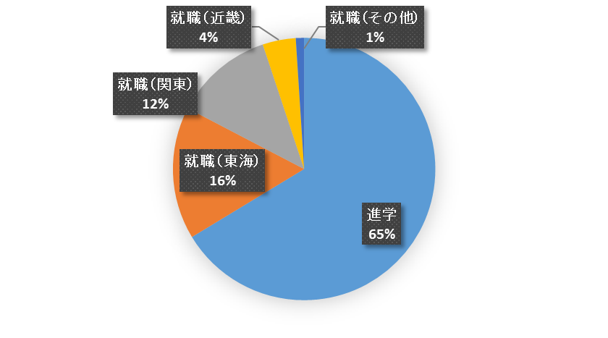
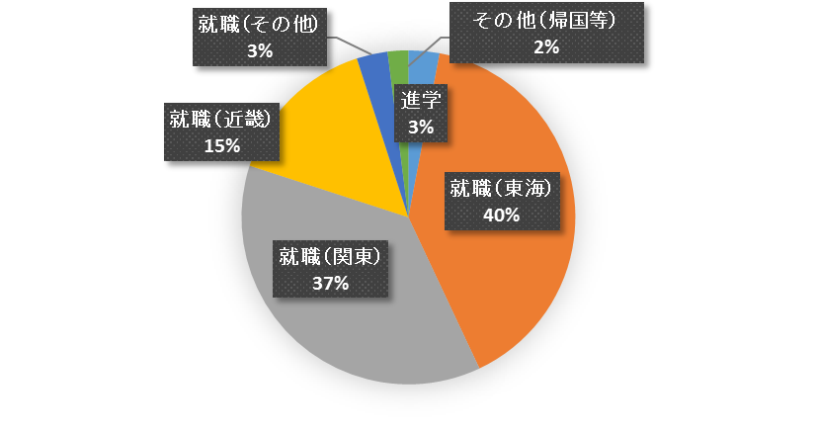
Career path of graduates
Rate of employment : 99%
Master course
Employment
(Kinki)
4%
Employment
(Other)
1%
Employment
(Other)
3%
Other
2%
Employment
(Kanto)
12%
Employment
(Kinki)
15%
Dr course
3%
Employment
(Chubu)
16%
Employment
(Chubu)
40%
Master course
65%
Employment
(Kanto)
37%
Under graduate
Notes:
工学部を卒業した学生の約6割強が大学院に進学します．また大学院を修了した学生のほとんどは，いわゆるメーカーに就職しています．就職を希望する学生の就職率はほぼ100％です．

Slide 23
Priority researches in engineering area
1. Environment and energy science and technology
2. Nano-material science and technology
3. Bio- and medical engineering
4. Optical engineering
5. Manufacturing technology
Notes:
Here are our priority researches in engineering area.
Environment and energy science and technology,……..

Slide 24
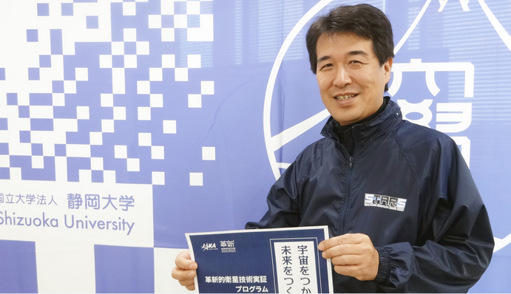
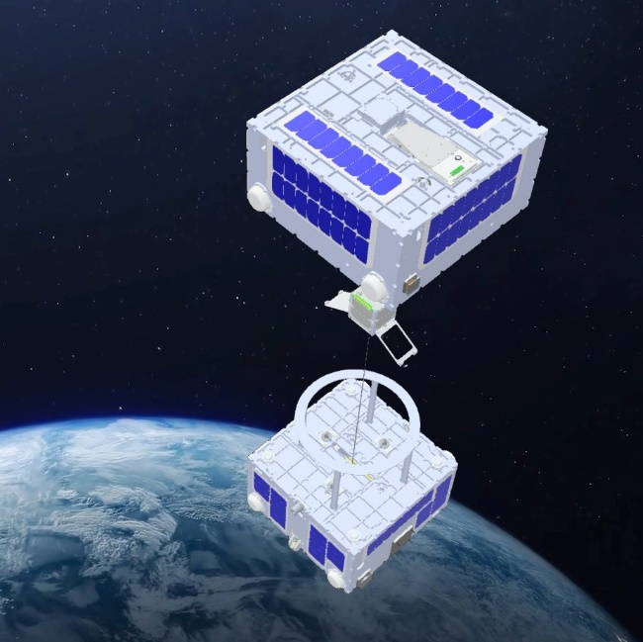
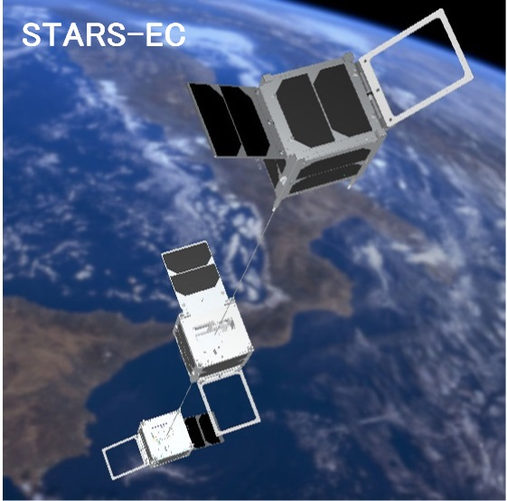
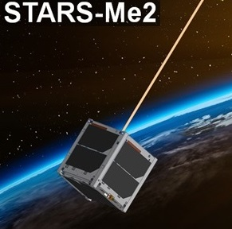
Future Goals
Space Orbital Elavator & Space Debris Removal
Prof. NOUMI Lab.
Dept. of Mechanical Engineering
STARS-X
STARS-EC (#7)
STARS-Me2 (#6)
Under development
Decayed
Under development

Slide 25
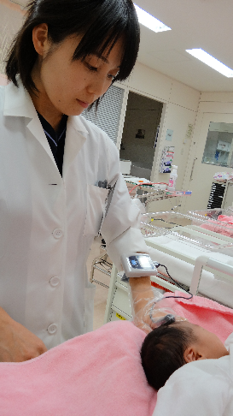
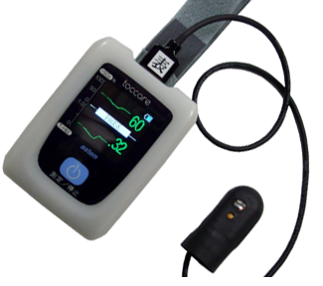
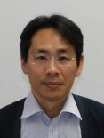
Bio- and medical engineering
Check of blood oxygen concentration with optical sensor
Prof. NIWAYAMA Lab.
Notes:
1.Next is bio- and medical engineering field,
2.This optical sensor can check the blood clot by measuring the blood flow.
3.We can avoid the brain and heart diseases.
4.The optical sensor is compact and easy for mass production.

Slide 26
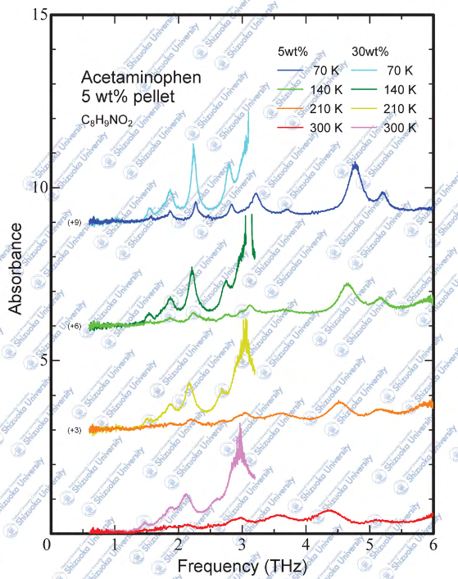
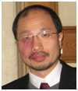
THz Spectral Database for Pharmaceuticals
Prof. SASAKI Lab.
Dept. of Electronics and
Materials Science

Slide 27
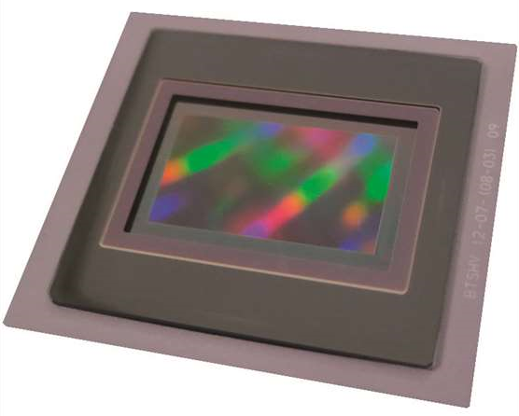
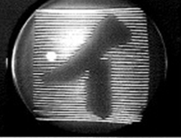
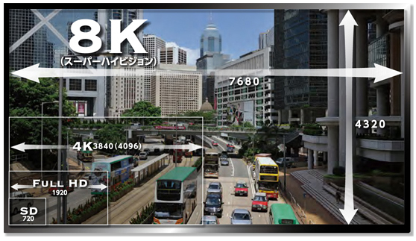
Television technology
World first electrical television was invented by Prof.Takayanagi.（1926）
８Ｋ Image sensor
World only one
(Brookman Technology)
１００years
１９２６

Slide 28
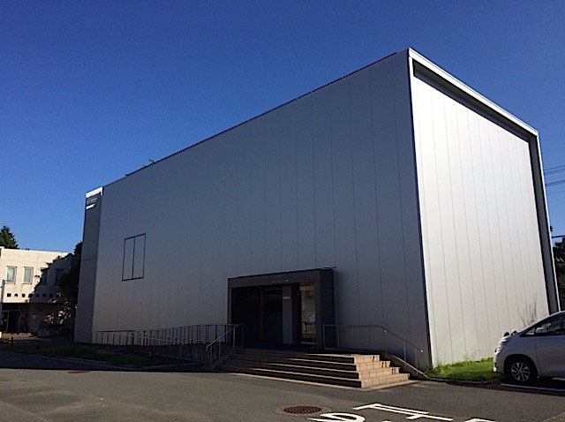

Takayanagi Memorial Hall
Notes:
28
新 浜松キャンパス施設説明スライド

Slide 29
International student exchange

Slide 30
Number of International students(2023)
Total number in Hamamatsu Campus (182)
Undergraduate & Master course of Engineering (92)
Viet Nam (34), China (8), Indonesia (14),
India(15), Bangladesh (2), Others(19)
Doctoral students in Hamamatsu Campus (49)
India(15),Indonesia(5),China (8),
Bangladesh (10), Others
Notes:
We have 235 foreign students in Hamamatsu campus last year.

Slide 31
Acceptance of foreign students
Government-sponsored foreign
student
2. Self-supporting foreign student
3. Asia Bridge Program foreign student
Notes:
1.We accept several kinds of foreign students:
2.Many foreign students entered Engineering Faculty by ABP program.

Slide 32








Asia Bridge Program (ABP-SU)
Your Path to Global Marketplace
Tuition Support
& ABP Scholarship
Intensive Japanese Language Training
2
Japanese Global Companies
Industry-Academia Collaborative Classes
Internships
http://www.abp.icsu.shizuoka.ac.jp
Be the bridge between Shizuoka and your country!!

Slide 33
Asia Bridge Program (ABP-SU)
Your Path to Global Marketplace
Tuition Support
& ABP Scholarship
Intensive Japanese Language Training
2
Japanese Global Companies
Industry-Academia Collaborative Classes
Internships
http://www.abp.icsu.shizuoka.ac.jp
Be the bridge between Shizuoka and your country!!

Slide 34
Eligible countries for ABP
Tuition Scholarship available for
Bachelor's courses:
  India, Indonesia, Myanmar, Thailand & Vietnam
Master's courses:
  Bangladesh, China, India, Indonesia, Laos, Malaysia,
  Mongolia, Myanmar, Nepal, Philippines, Singapore,
  South Korea, Sri Lanka, Taiwan, Thailand & Vietnam

Slide 35

Asia Bridge Program (ABP)
ABP is a unique industry-academia collaborative program
  undergraduate program in Japanese
  graduate program in English
In addition to exemption from the application and enrollment fees, it waives the tuition of the first year.
Tuition

Slide 36


Scholarships & Tuition Fees
Graduate student : 1st year
Full Tuition
Scholarship
Waived
Waived
Financial funds worth \ 834,800 (470,500 INR)
No fee for the 1st year of the study
2nd year: Full or half Tuition Scholarship offered according to the academic performance of 1st year

Slide 37
Other Scholarships
【Pre-departure】
Mabuchi International Scholarship Foundation 1 yr.
MEXT Honors Scholarship for Privately Financed Inter.Students
【While studying in Japan】
MEXT Honors Scholarship for Privately Financed Inter. Students
Mitsui DuPont Fluor chemicals
JGCS Scholarship Foundation
Sato Yo International Scholarship Foundation
Mitsubishi Corporation International Scholarship
SHIZUGIN Asia Scholarship （2 yrs.）
ENKEI Scholarship Foundation（1 yr.）
Kyoritsu FoundationScholarship (2 yrs.)
Honda Benjiro Shogaku Kikin (up to 3 yrs.)
Shizuoka University International Foundation

Slide 38

Asia Bridge Program (ABP)
Photo after the entrance ceremony
Notes:
1.They are Asian foreign students invited by NIFEE program.
2.This program finished last year and new program started from this year.

Slide 39



Social programs
Student lounge
https://www.suoic.shizuoka.ac.jp/international/international-exchange-lounge/
Shizuoka
Hamamatsu
Video
Notes:
https://youtu.be/kX61UtQ6TsE

Slide 40


Japanese language lessons
In-sessional Japanese language courses are offered throughout the year.
The courses are provided free of charge.
The courses cater to students ranging from beginners to advanced levels.

Slide 41




Accommodation guaranteed for 1st year
International Residence
Akebono Dormitory
Notes:
●静岡大学浜松キャンパスには３つの寮があり、そのうち２つの寮に留学生は滞在します。
●左が国際交流会館、右があけぼの寮です。どちらも家具・家電付です。
国際交流会館は留学生専用、あけぼの寮は日本人も住んでいます。
●どちらも基本は１年間しか住むことができません。１年後はCOOPでアパート紹介を行っているのでそこから探すことになります。

Slide 42
ABP-SU How to Apply : Master’s courses
Find a prospective academic supervisor
  Provide transcript, research background information
  List of Professors online (ABP Website)
  Check Professor’s research & publication
Receive the Acceptance letter from your
prospective supervisor
Online Application : Submit documents
Skype Interview Test
Until
Feb/March
By the end
Of March
April/ May
Application guide will be up on ABP Website in January

Slide 43
SSSV Program
Short Stay and Short Visit
In 2011, Faculty of Engineering implemented an international exchange.
The program enables Shizuoka University students to do research discussion at overseas universities or laboratories.

Slide 44
SSSV Program
to improve skills required by professional engineers at a symposium and share experiences with foreigner students.
to cultivate presentation skills.
to give participants a more balanced and polished international perspective.
to promote the self development of participants.
to promote academic collaboration between universities.
I decided to give priority to the labs which send students to IITH.

Slide 45
SSSV Program
to improve skills required by professional engineers at a symposium and share experiences with foreigner students.
to cultivate presentation skills.
to give participants a more balanced and polished international perspective.
to promote the self development of participants.
to promote academic collaboration between universities.

Slide 46

Ph.D. Program
http://gsst.shizuoka.ac.jp/

Slide 47
Research activities
Research institutes (2):
Electronics and Green Science and Technology
Grants-in-Aid for Scientific Research
(National-level, Research council funding)
408 projects
\1.3 billion (total)
Collaborative research
244 projects
\463 million (total)
Funded research
102 projects
\723 million (total)
FY 2021
【 Grants-in-Aid for Scientific Research 】

Slide 48
Research activities
Research institutes (2):
Electronics and Green Science and Technology
Donation
1,173
\590 million (total)
Grants-in-Aid for Scientific Research
(National-level, Research council funding)
426 projects
\1,076 million (total)
Collaborative research
269 projects
\459 million (total)
Funded research
112 projects
\958 million (total)
FY 2022
【 Grants-in-Aid for Scientific Research 】

Slide 49







Relationship between
BME and Shizuoka Univ.
Óbuda University
Notes:
ÓE
mű- (“technical”) +‎ egyetem (“university”)

Slide 50
“Inter-Academia (IA)” Community
Shizuoka University and collaborating Central-Eastern European universities are involved in the active exchange of research, students and doctoral courses to improve academic progress and achievement in science and technology.
Alexandru Ioan Cuza University, Romania
Warsaw University of Technology, Poland
Budapest University of Technology and Economics, Hungary
Riga Technical University,
Latvia
Kaunas University of Technology, Lithuania
Óbuda University,
Hungary
Taras Shevchenko National University of Kyiv, Ukraine
Moldova State University, Moldova
Masaryk University,
Czech Republic
Gomel State University, Belarus
Comenius University,
Slovakia
Saint Petersburg State Institute of Technology, Russia
Wuppertal University, Germany
Sofia University,
Bulgaria
Shizuoka University,
Japan
https://iac.icsu.shizuoka.ac.jp/en/

Slide 51


IA activities
Inter-Academia Conference,
started with four partner universities in 2002, is the keystone of the IA community's exchange.
Year | Place | Participants
2002 | Bratislava, Slovakia | 67
2003 | Warsaw, Poland | 59
2004 | Budapest, Hungary | 82
2005 | Wuppertal, Germany | 72
2006 | Iasi, Romania | 127
2007 | Hamamatsu, Japan | 195
2008 | Pecs, Hungary | 90
2009 | Kazimierz Dolny, Poland | 90
2010 | Riga, Ratvia | 130
2011 | Sucevita, Romania | 101
2012 | Budapest, Hungary | 78
2013 | Sofia, Bulgaria | 60
2014 | Riga, Latvia | 160
2015 | Hamamatsu, Japan | 145
2016 | Warsaw, Poland | 140
2017 | Iasi, Romania | 81
2018 | Kaunas, Lithuania | 86
2019 | Budapest & Balatonfured, Hungary | 51
2021 | Gomel, Belarus (hybrid) | 242
2023 | Hamamatsu, Japan (hybrid) | 145
20th conference at Hamamatsu
Double Degree Program for doctoral course
enables the student to obtain two kinds of doctoral degrees which are conferred by Shizuoka University and home university.
Mobility of students and faculties
has been enhanced based on the supports including MEXT scholarship, Erasmus+ program, Suzuki Foundation and so on.

Slide 52
Exchange achievements between BME and SU
The Agreement on Exchange Programme between Budapest University of Technology and Economics and Shizuoka University was signed on Nov. 21, 2000.
BME organized Inter-Academia Conference in 2004 and 2008.
SU has welcomed visiting researchers from BME with the grant from Suzuki Foundation.

Slide 53





Researches from BME by support of Suzuki Foundation
No. | Name | Period of stay in Japan
1 | Dr. MADARSZ Janos | Oct.1999 – Jun.2000
2 | Dr. DINNYES Csaba | Apr.2001 – Sep.2001
3 | Dr. ORSOLYA Takacs | Oct.2002 – Mar.2003
4 | Dr. GENOVEVA Filipcsei | Apr.2005 – Jul.2005
5 | Dr. ROVID Andras | Mar.2006 – Mar.2007
マダラス ヤーノス先生
＠金子研
デニイース チャバ先生
＠藤森研
オルソルヤ タカチさん
＠市川研
ゲノヴェバ フィリプチュイ先生
＠須藤研
ロバイド アンドレアス先生
＠橋本研
Notes:
We support subsidizing program for Hungary and India.
Researchers from BME reached 20 people from 1999y.

Slide 54




Researches from BME by support of Suzuki Foundation
No. | Name | Period of stay in Japan
6 | Mr. STUBAN Norbert Geza | Mar.2007 – Mar.2008
7 | Mr. ZENTAI András | Apr.2008 – Mar.2009
8 | DR. WIENER Gabor | Apr.2009 – Jun.2009
9 | Ms. PEZSA Nikolett | Apr.2010 – Mar.2011
10 | Dr. KOVACS Daniel Laszlo | Apr.2011 – Mar.2012
＠新谷研
スタバン ノルベルトさん
＠庭山研
ゼンタイ アンデアスさん
＠片山研
ペズサ ニコレットさん
＠佐古研
コバチ ダニエル ラスロ先生
＠情報・渡辺研
Notes:
We support subsidizing program for Hungary and India.
Researchers from BME reached 20 people from 1999y.

Slide 55





Researches from BME by support of Suzuki Foundation
No. | Name | Period of stay in Japan
11 | Ms. ROVIDNE BOGARDI-MESZOLY Agnes | Apr.2012 – Mar.2013
12 | Ms. BORDÁCSNÉ BOCZ Katalin | Sep.2013 – Feb.2014
13 | Mr. SOTI Lajos Péter | Apr.2014 – Mar.2015
14 | Dr. SALVI Peter | Sep.2015 – Aug.2016
15 | Ms. NAGYGYORGY Viola | Apr.2016 – Nov.2016
ロヴァイドゥネ ボガールディ メーソィ アーグネシュ先生
＠情報・石川研
ボルダチネ ボッツ カタリンさん
＠東郷研
ショーティー ラヨシュ ピーター
さん＠間瀬研
サルビ ペーテル先生
＠三浦研
ナジジャージ ビオラさん
＠奥谷研
Notes:
We support subsidizing program for Hungary and India.
Researchers from BME reached 20 people from 1999y.

Slide 56




Researches from BME by support of Suzuki Foundation
No. | Name | Period of stay in Japan
16 | Mr. VAMOSI Peter | Aug.2017 – Jan.2018
17 | Mr. NAGY Balazs | Mar.2019 – Sep.2019
18 | Mr. KOVACS Szilard | Jun.2022 – Aug.2022
19 | Dr. NAGY Robert | Sep.2022 – Feb.2023
バモシ ペーテルさん
＠間瀬研
ナジイ バラズさん
＠小林研
コバチ シラルード先生
＠青木研
ナジ ロベルト先生
＠三浦研
Notes:
We support subsidizing program for Hungary and India.
Reseacher from BME reached 20 people from 1999y.

Slide 57

Researches from BME by support of Suzuki Foundation
No. | Name | Period of stay in Japan
20 | Dr. FRUZSINA BANHEGY Dorottya | Sep.2023 – Mar.2024
21
ドロッチャさん
＠小南研
Notes:
We support subsidizing program for Hungary and India.
Researchers from BME reached 20 people from 1999y.

Slide 58
Suzuki foundation scholarship between IITH and SU
Started in 2018
Eligible: Teachers, PhD students or final year Master’s students
Place of research: Shizuoka University, Hamamatsu campus (Japan)
Period of stay: six months - one year
Allowances:
  Round-trip air ticket
  50,000 JPY for starting the new life in Japan
  Up to 300,000 JPY for teacher or 200,000 JPY for student per month
  30,000 JPY per month for accommodation
  Special expense for conference, etc.
720,000 Ft

Slide 59
Next mission
Mutual visits by executives
Ms. Füzesi, Head of Department of International affairs, BME visited SU in 2018.
Prof. Kawata, Dean, Faculty of engineering, SU and Prof. Matsuda, Organization for International Collaboration, SU visited BMU in 2019.
Prof. Korondi, Faculty of Mechanical Engineering visited SU in 2020.
Difficulty of communication by Corona pandemic
​
It’s time to rebuild the relationship!

Slide 60
Matching between researchers
Researches list in Faculty of Engineering at Shizuoka University (Excel file)
Please circulate this list of researchers in SU with their research field and try to match them with interested researchers in BME.

Slide 61

Thank you for your kind attention.
Köszönöm
（クゥスヌム）
ありがとうございました。

